Slide 1
Motif library of Islamic art

Slide 2

Persian designs

Slide 3


Slide 4
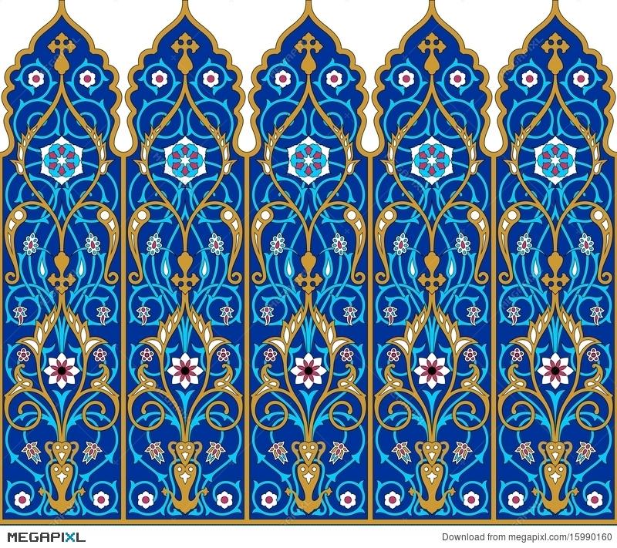

Slide 5


Slide 6
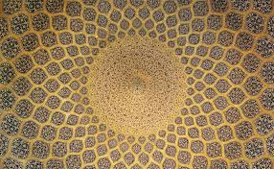

Slide 7
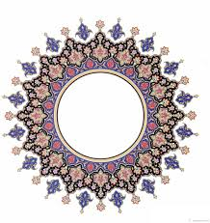

Slide 8

Ottoman Design

Slide 9


Slide 10
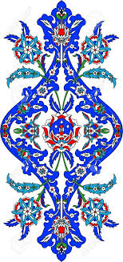

Slide 11


Slide 12
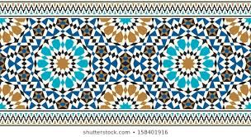
Moroccish Design

Slide 13
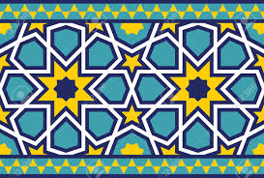

Slide 14
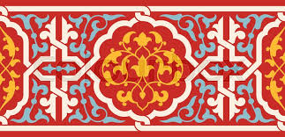

Slide 15
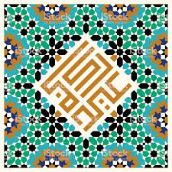

Slide 16
